Slide 1
NexT8
App Moqups

Slide 2
Concept - Synthesis
Next8 Limited property ; 2nd of March 2016
Next8 – the App that connects people through activities
4 Key sub ideas: Next8 the App allows you to:
(1) Meet people around 1 activity in the next hours
(2) Create the activity you want to do in the next hours and get people to join you
(3) Make new connections after sharing a good time
(4) No calendar, freemind of improvisating what your mood tell you today

Slide 3
In more details…
Next8 Limited property ; 2nd of March 2016
(1) Meet new people to share & participate in your favourite activities…create & join & enjoy
(2) Be Spontaneous/In the moment – no need for long term planning, what’s happening where you live in the next 8 hours……..be active when & where you want……or maybe take part in a mystery activity……..put some energy & fun back into your free time & weekends
(3) Make new connections instantly & effortlessly – Next8 is passionate about connecting people with activities, instantly & effortlessly – moved to a new city and want to meet new friends to share in your activities…..etc etc

Slide 4
NexT8 - 8 Key functions
Next8 Limited property ; 2nd of March 2016
Search and Join an activity (search per category)
Create an activity (corresponding to a category)
Search and Join an activity (search on the map)
Join a Mystery activity
Create a Mystery activity
Check your activities
Chat with members
Send notifications regarding the activities

Slide 5
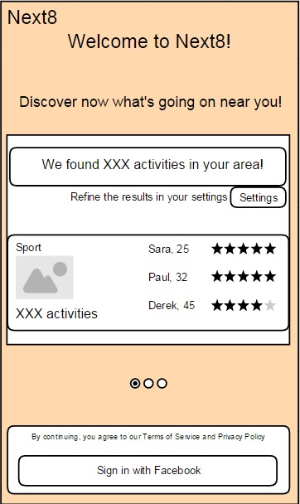
Moqups – Create Profile1
Next8 Limited property ; 2nd of March 2016

Slide 6
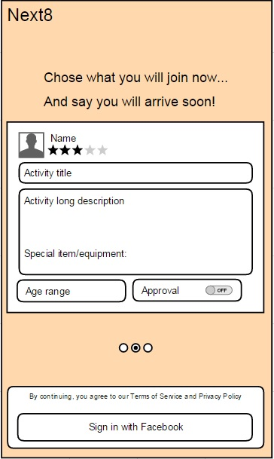
Moqups – Create Profile2
Next8 Limited property ; 2nd of March 2016

Slide 7
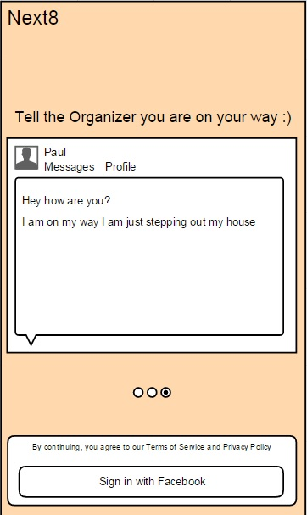
Moqups – Create Profile3
Next8 Limited property ; 2nd of March 2016

Slide 8
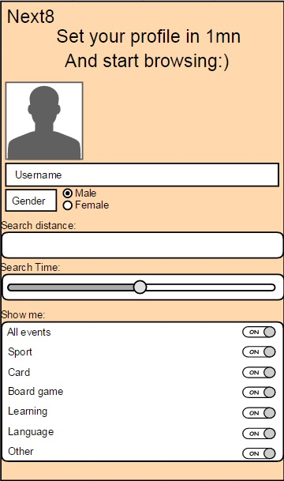
Moqups – First settings setup
Next8 Limited property ; 2nd of March 2016

Slide 9
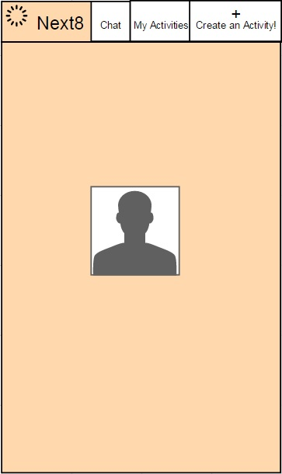
Moqups – Results waiting screen
Next8 Limited property ; 2nd of March 2016

Slide 10
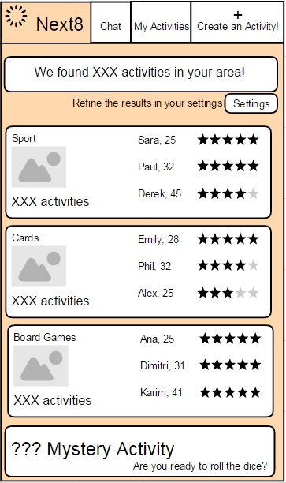
Moqups – Dashboard
Next8 Limited property ; 2nd of March 2016

Slide 11
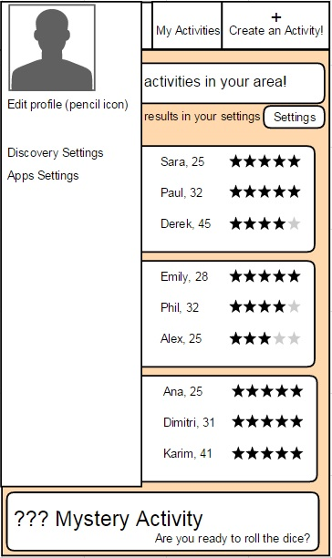
Moqups – Profile pop-up
Next8 Limited property ; 2nd of March 2016

Slide 12
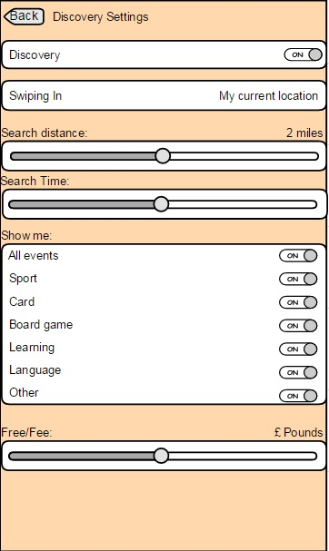
Moqups – Discovery settings
Next8 Limited property ; 2nd of March 2016

Slide 13
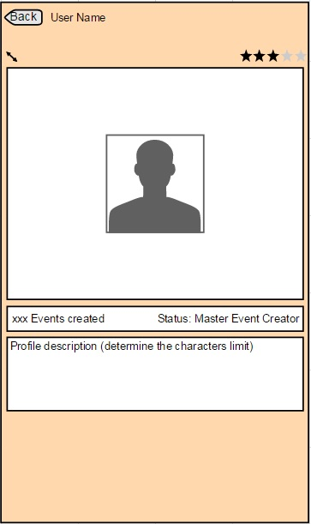
Moqups – Profile settings
Next8 Limited property ; 2nd of March 2016

Slide 14
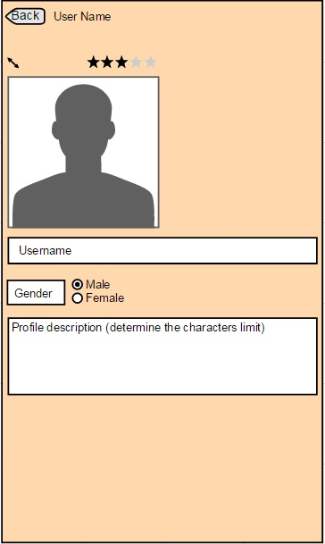
Moqups – Edit settings
Next8 Limited property ; 2nd of March 2016

Slide 15
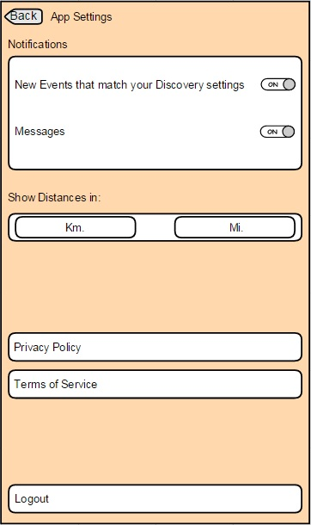
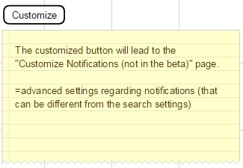
Moqups – App settings
Next8 Limited property ; 2nd of March 2016

Slide 16
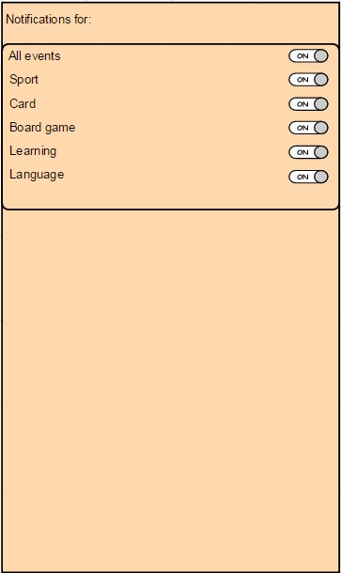
Moqups – Customize notifications (not in B)
Next8 Limited property ; 2nd of March 2016

Slide 17
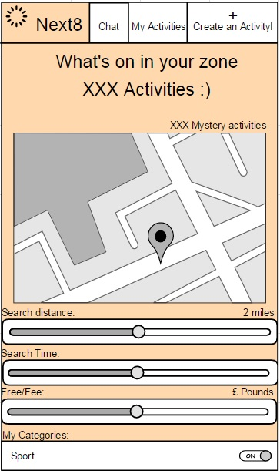
Moqups – Activity map
Next8 Limited property ; 2nd of March 2016

Slide 18
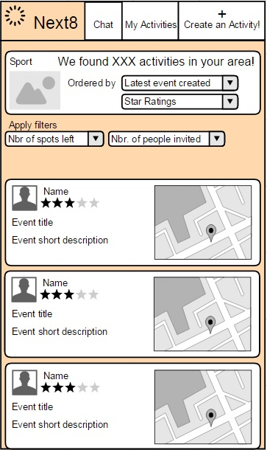
Moqups – Activity category feed page
Next8 Limited property ; 2nd of March 2016

Slide 19
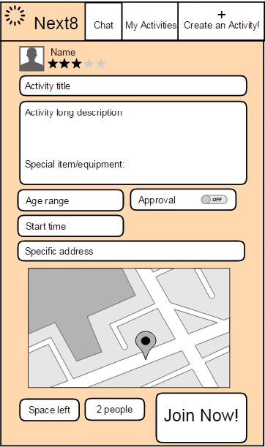
Moqups – Activity page

Slide 20
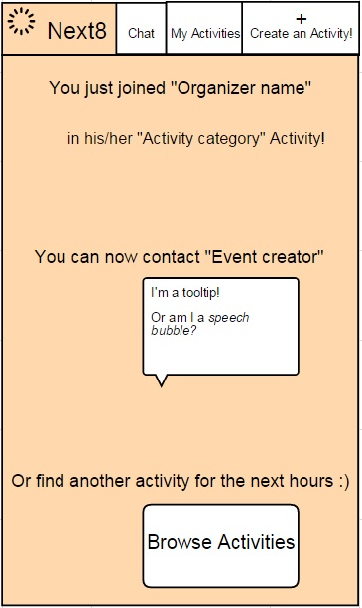
Moqups – Activity joined confirmation
Next8 Limited property ; 2nd of March 2016

Slide 21
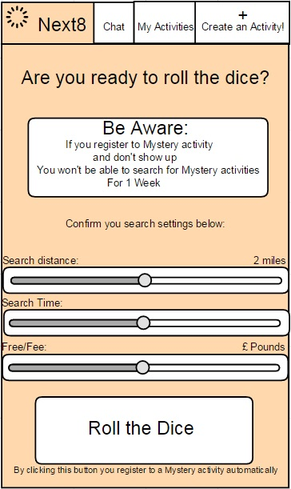
Moqups – Mystery search confirmation
Next8 Limited property ; 2nd of March 2016

Slide 22
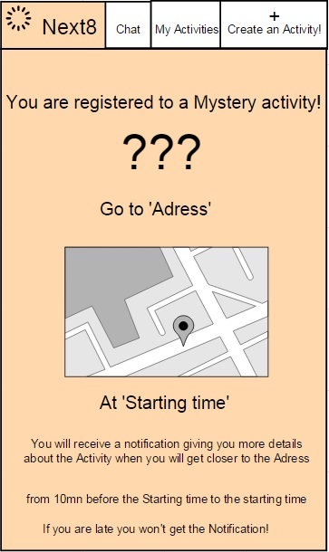
Moqups – Mystery activity confirmation
Next8 Limited property ; 2nd of March 2016

Slide 23
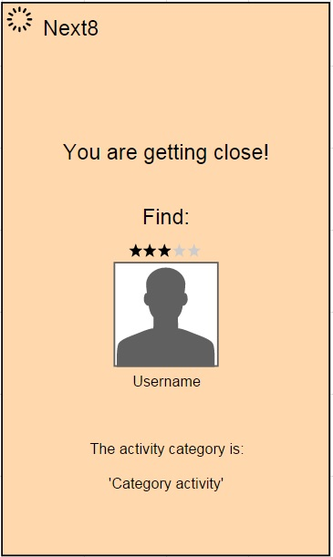
Moqups – Mystery pop-up notification
Next8 Limited property ; 2nd of March 2016

Slide 24
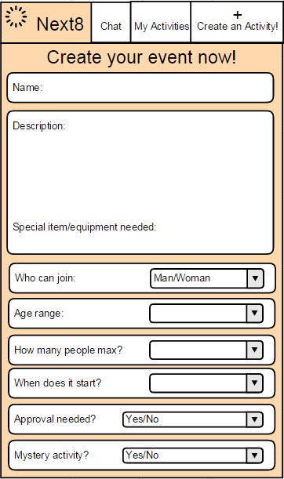
Moqups – Activity creation step1
Next8 Limited property ; 2nd of March 2016

Slide 25
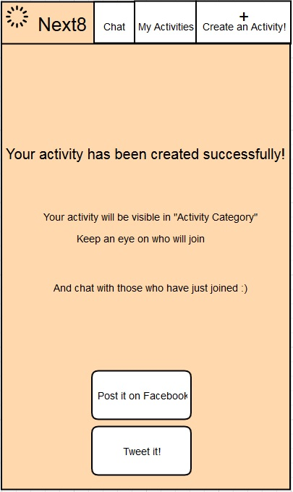
Moqups – Activity creation step2
Next8 Limited property ; 2nd of March 2016

Slide 26
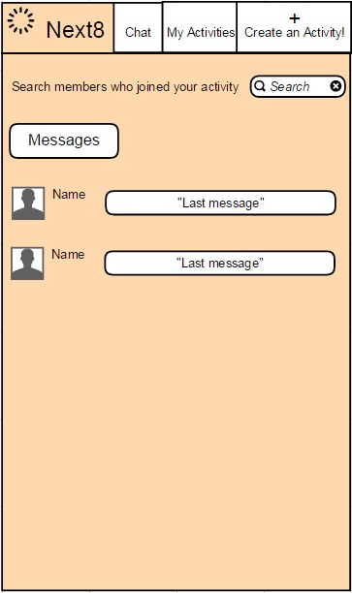
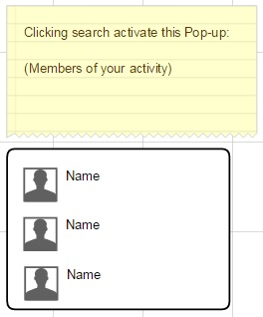
Moqups – Chat
Next8 Limited property ; 2nd of March 2016

Slide 27
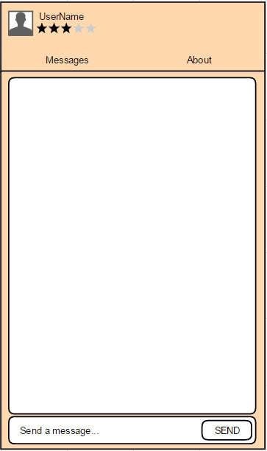

Moqups – Chat screen
Next8 Limited property ; 2nd of March 2016

Slide 28
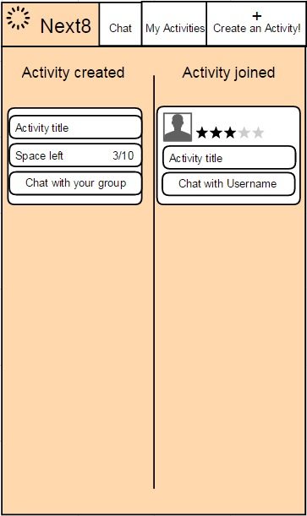
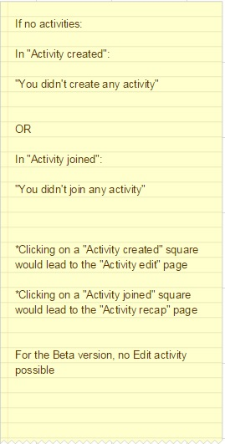
Moqups – My activities
Next8 Limited property ; 2nd of March 2016

Slide 29
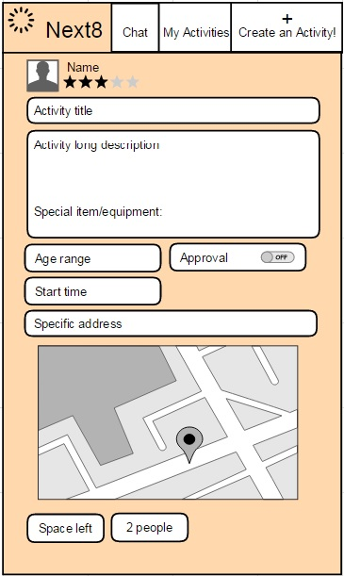
Moqups – Activities recap
Next8 Limited property ; 2nd of March 2016

Slide 30
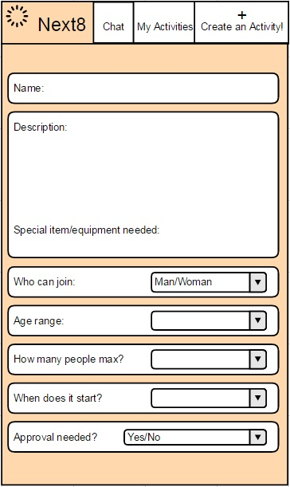

Moqups – Activity edit
Next8 Limited property ; 2nd of March 2016

Slide 31
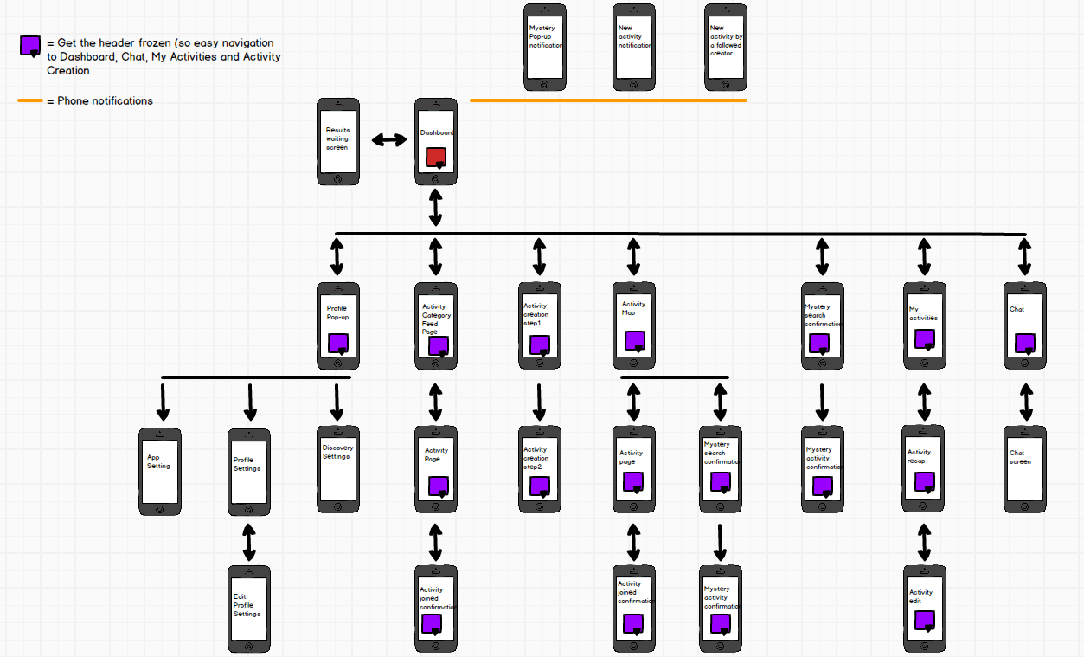
Wireframe
Next8 Limited property ; 2nd of March 2016

